Slide 1
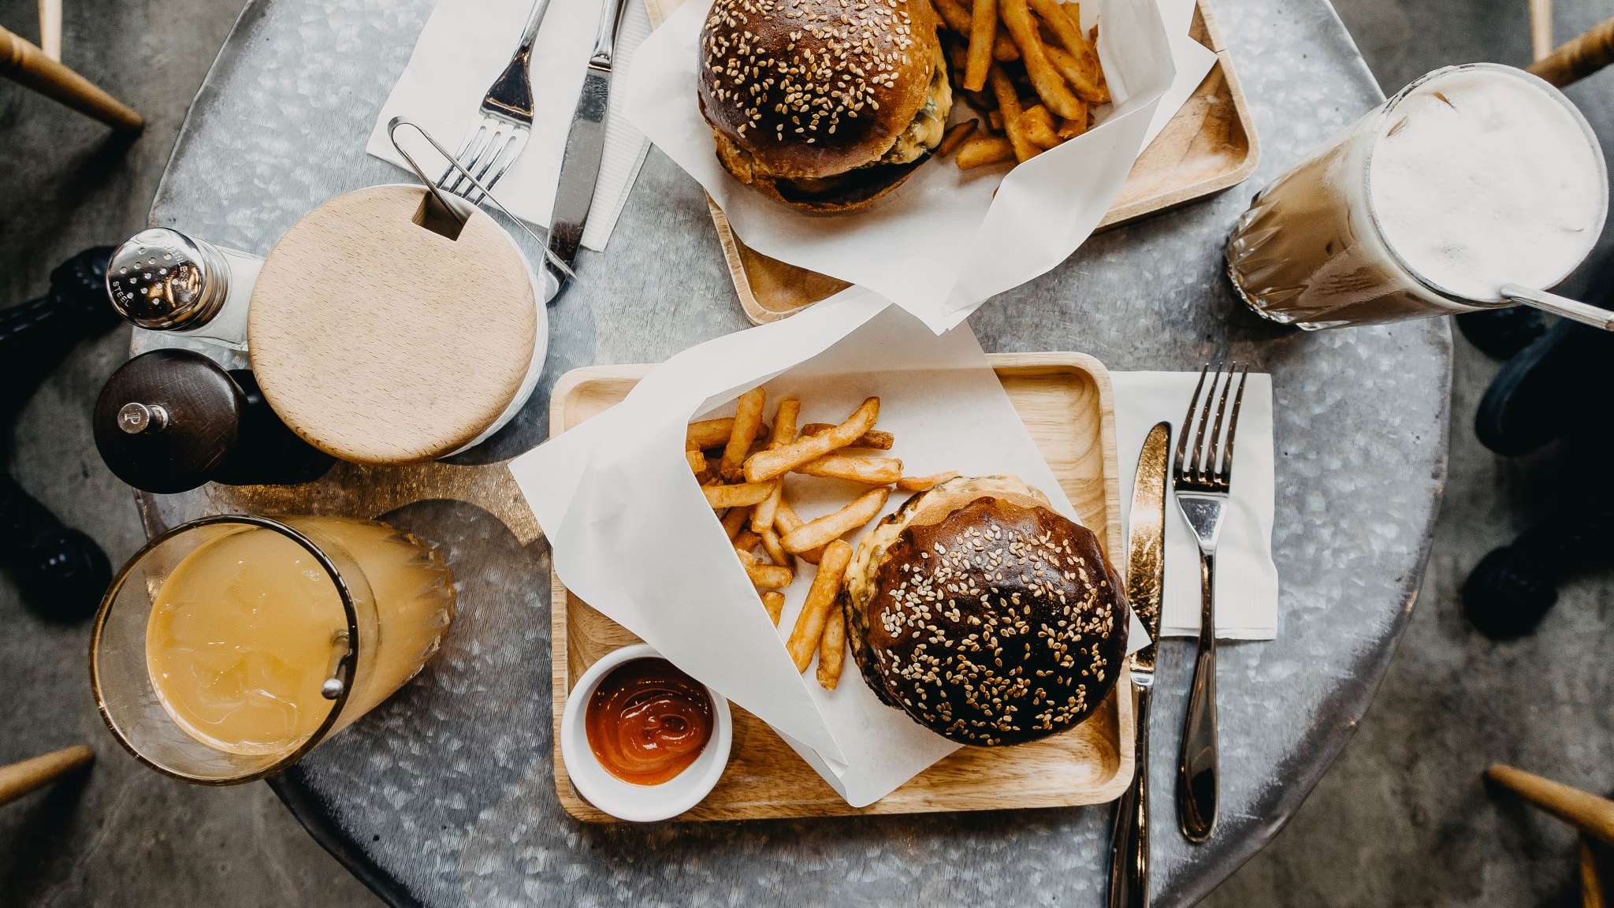
Dream Restaurant
Foundations of Web Development Group Project
Alireza Boroumandyar, Jack Lopes, Michael Ponte-Di Dio, Dimitar Velinov, Farzaneh Kazemi
FSD-03

Slide 2

PROBLEM STATEMENT
Develop a web site using all technique covered in the course such as HTML and CSS
Determine the purpose and target audience of our restaurant
Establish the content that is to be produced on our website
Settle on website style (color scheme, fonts, images, etc.)

Slide 3
Purpose of our Website
Attract people that conduct business meetings in a luxury restaurant
01
Get prospective customers to choose our restaurant over other eateries.
02
Present current menu (or special menu if available)
03
Display restaurant’s location, hours of operation and other relevant info
04
Allow customers to reserve a table online and make it easier to contact us
05

Slide 4
Audience
Intended audience of this business is primarily towards people who work in the same area of the restaurant (travellers and visitors are welcome)
The restaurant is mostly for adults aged 30 and over with high education level who are looking for high quality food

Slide 5
Branding
We determined that black, grey, and white were the best color scheme for our brand and website
These are the colors mostly associated with luxurious brands, specifically restaurants
Our website has a very modern and minimalist design which fits our brand accurately

Slide 6
Website Layout & Structure
index
Menus
Reservations
About us
Contact us
Orders

Slide 7
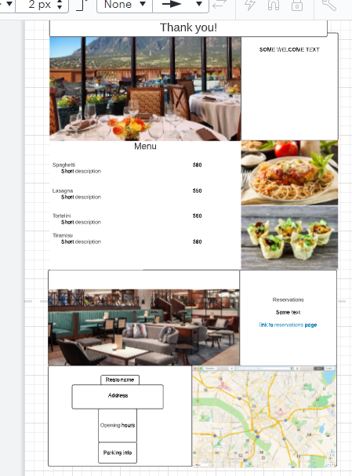
Main page
Main page serves as info and portal to other pages.
People can get some details with a quick glance or carry on deeper into the web site.

Slide 8
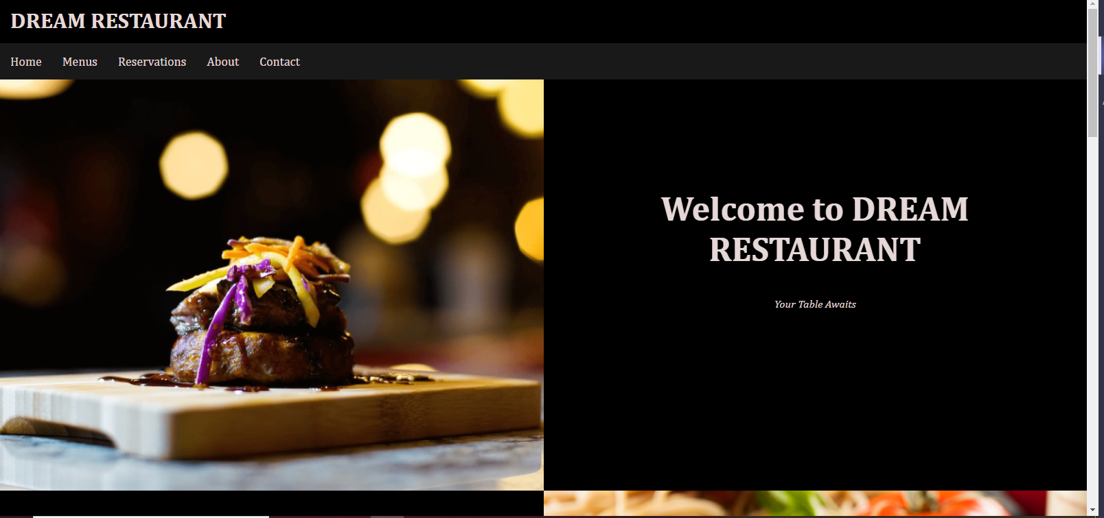
Some tantalizing pictures to entice the customers.

Slide 9
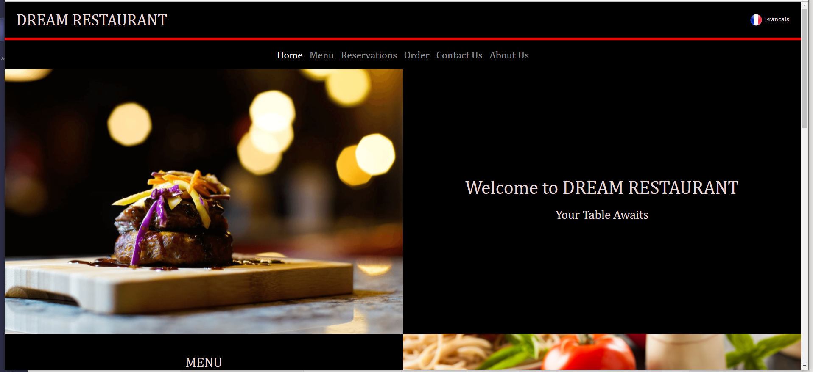
Updated Home page

Slide 10
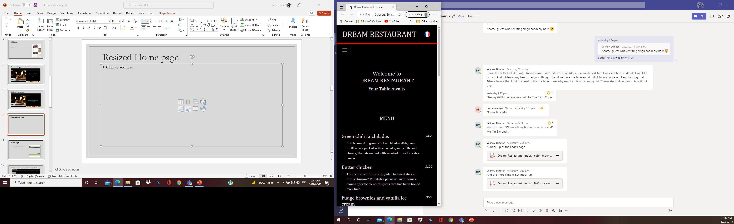
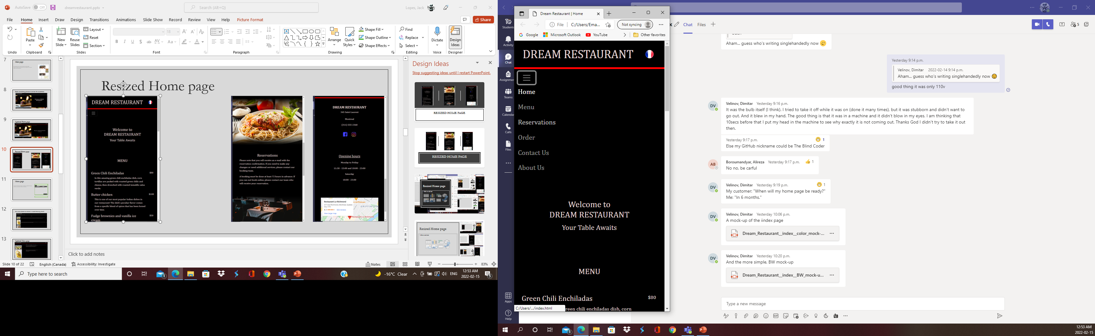
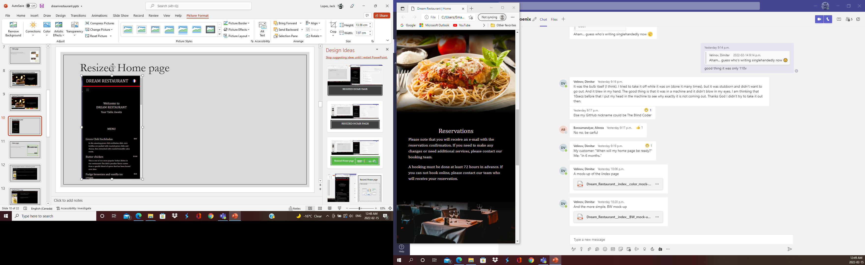
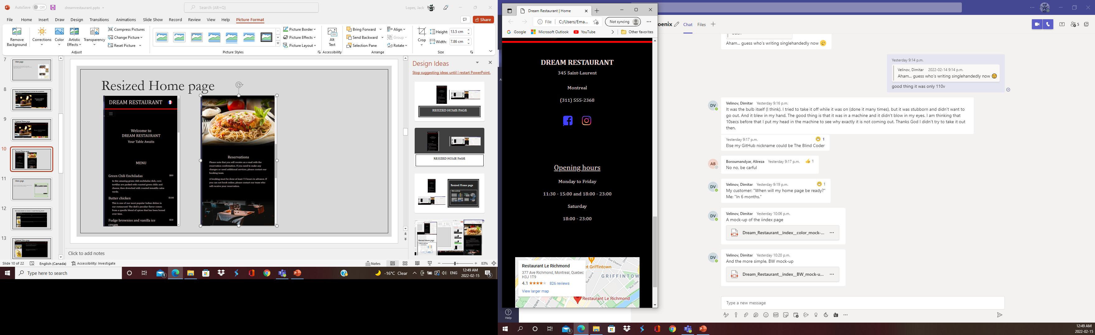
Resized Home page

Slide 11
Menu page
Purpose of the Menu page is to display a sample of various entrees, main dishes, drinks and desserts.

Slide 12
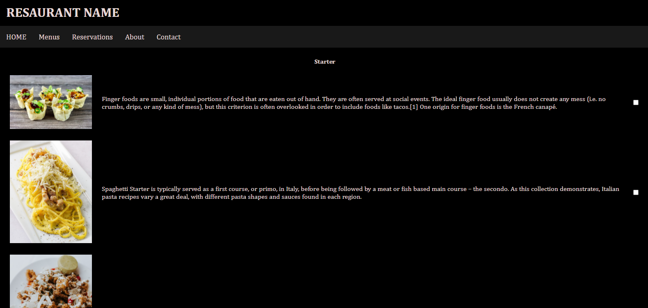
The menu shows the choices in mouth-watering details!

Slide 13
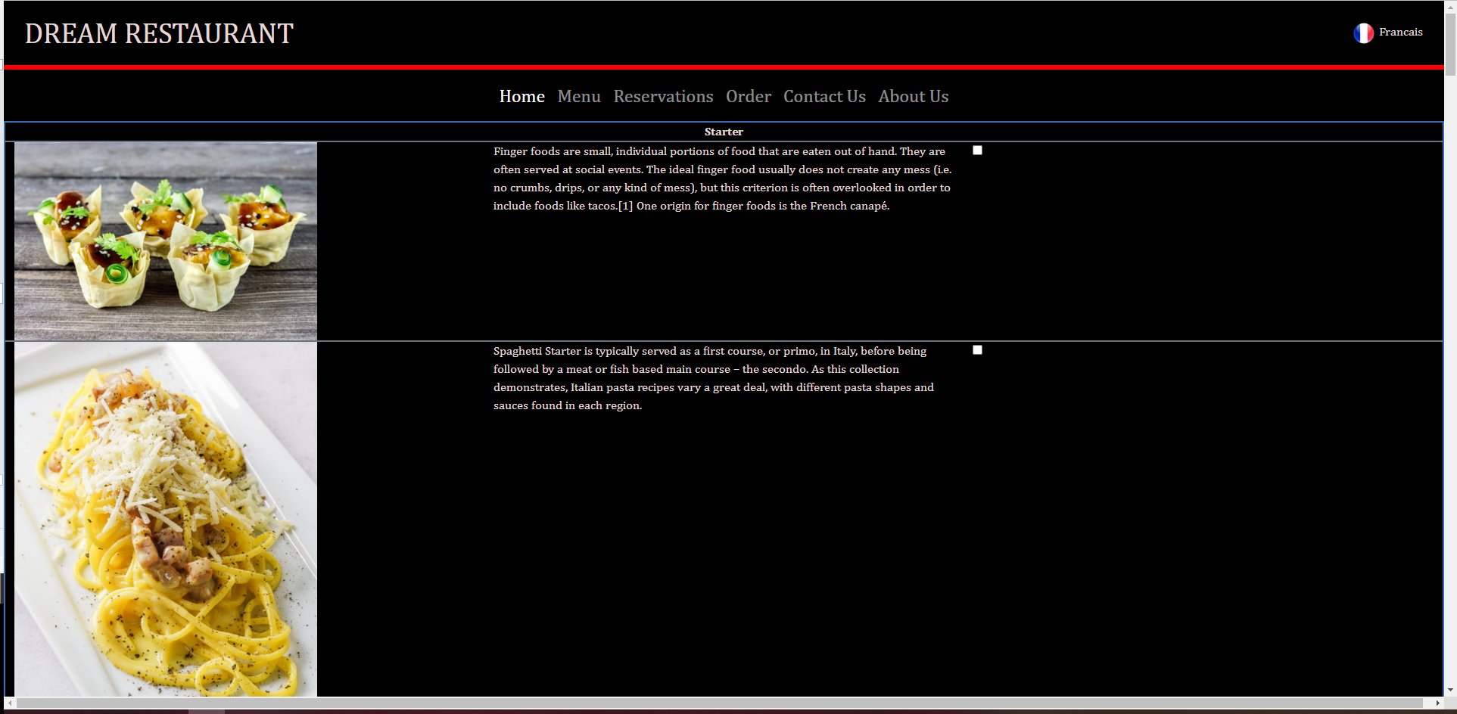
Updated Menu page

Slide 14
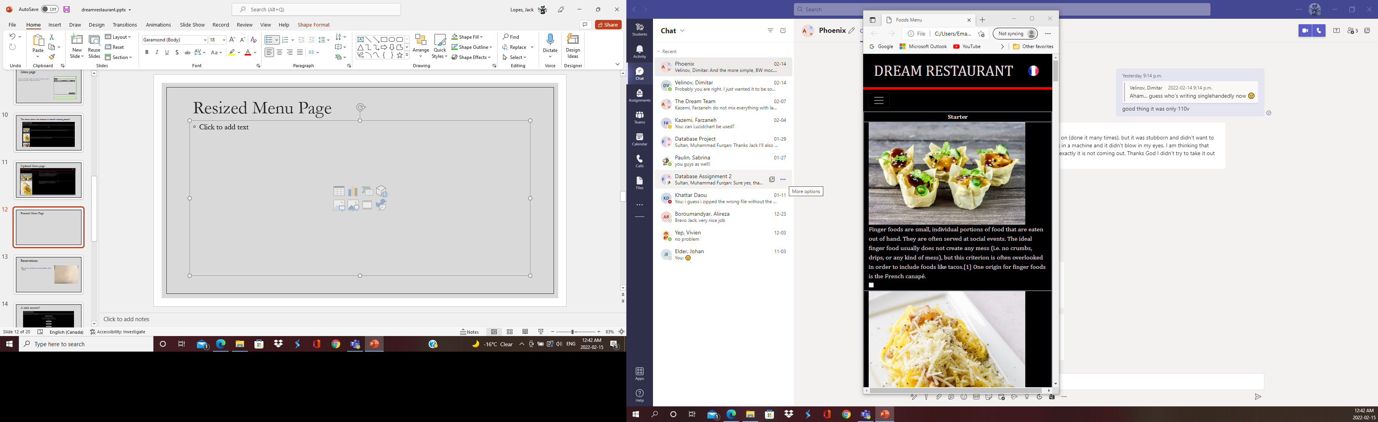
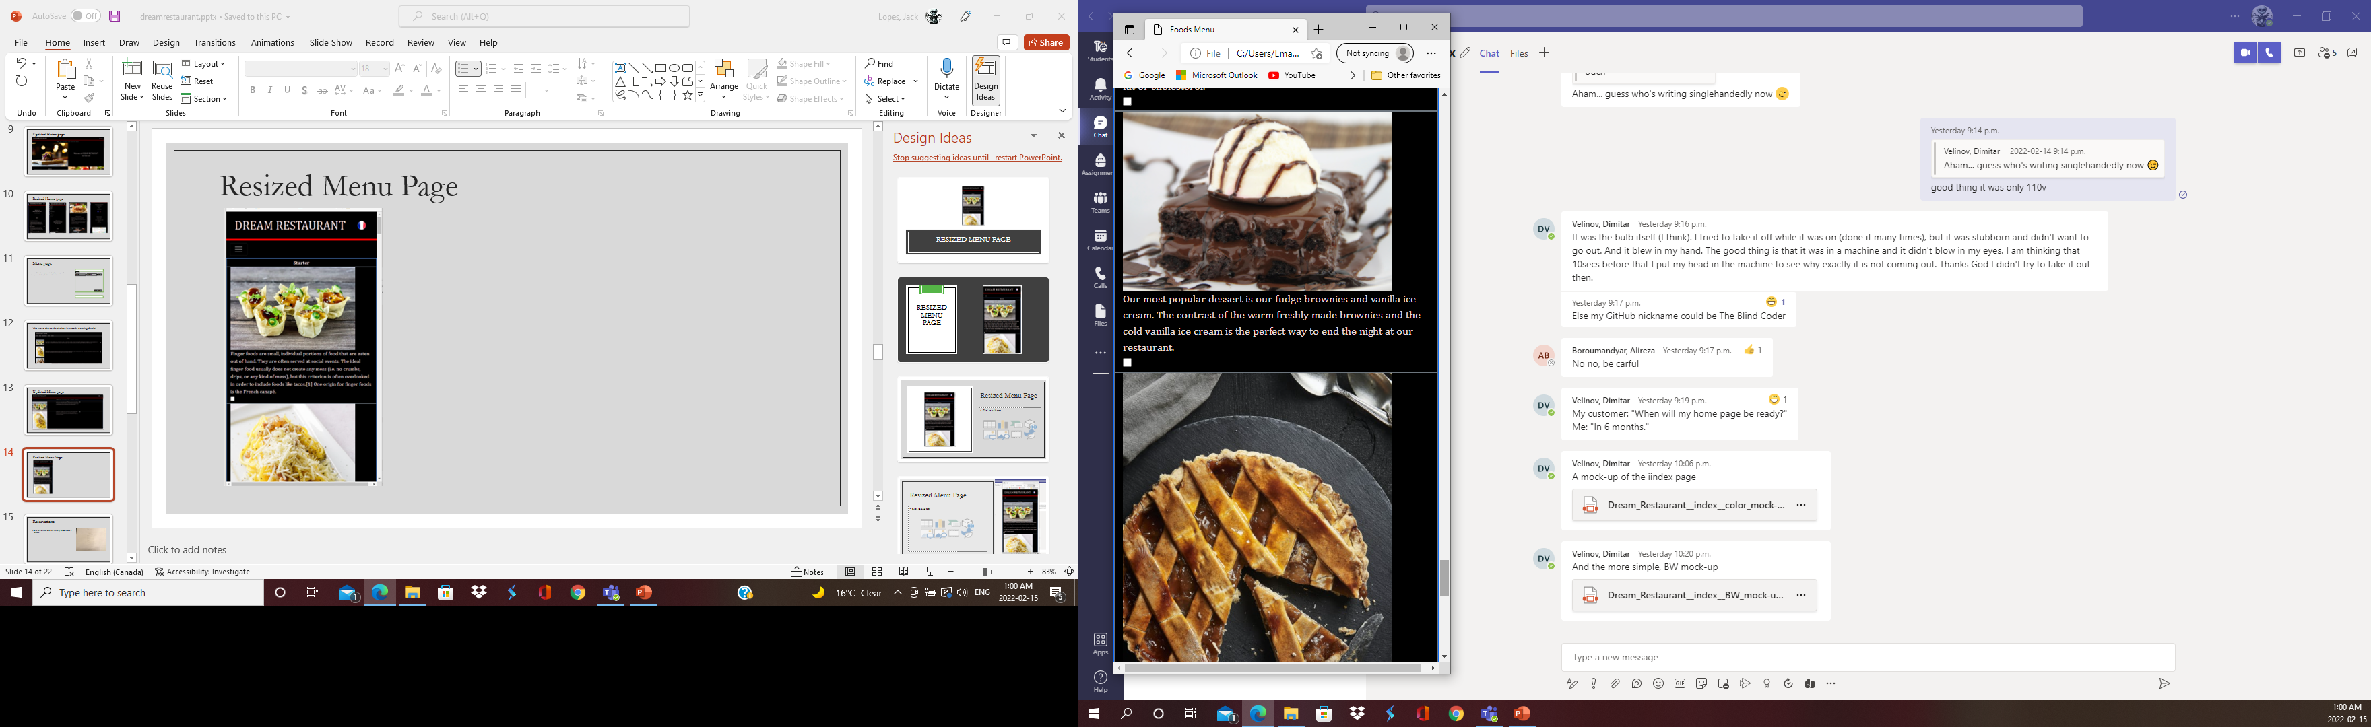
Resized Menu Page

Slide 15
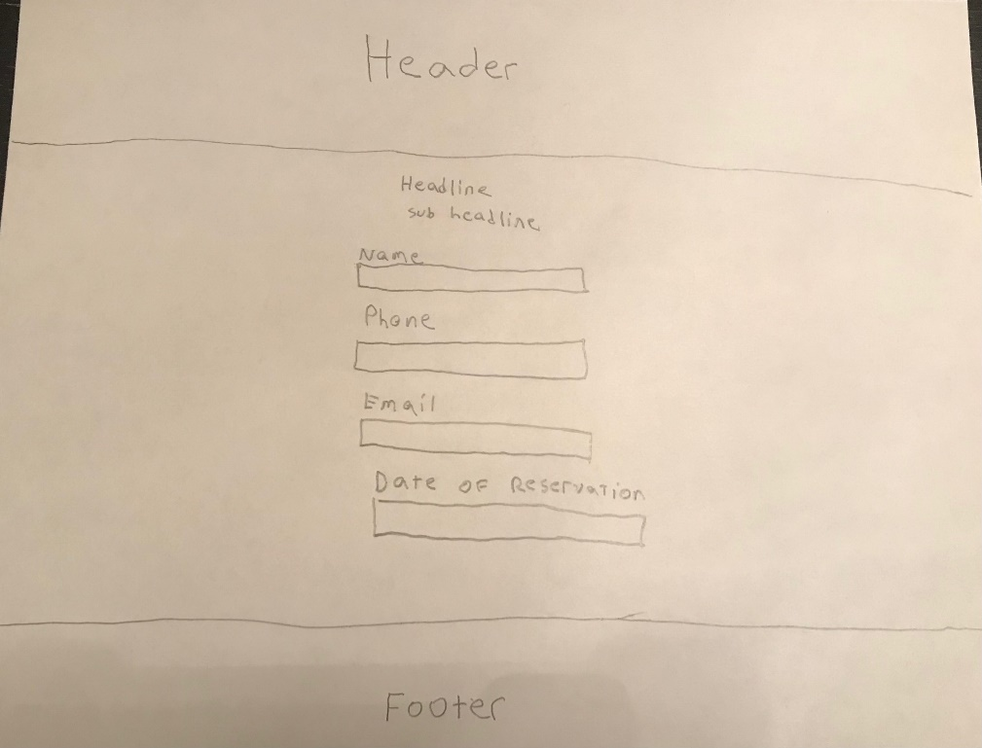
Reservations
Give the clients and web users the ability to book a table in advance.

Slide 16
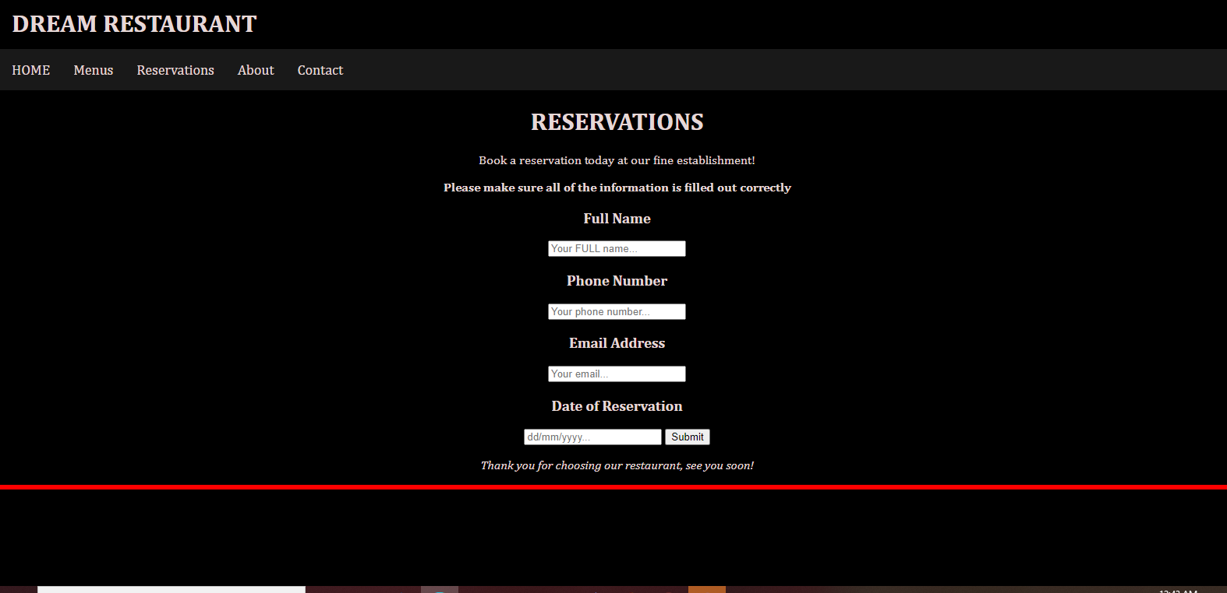
A table anyone?

Slide 17
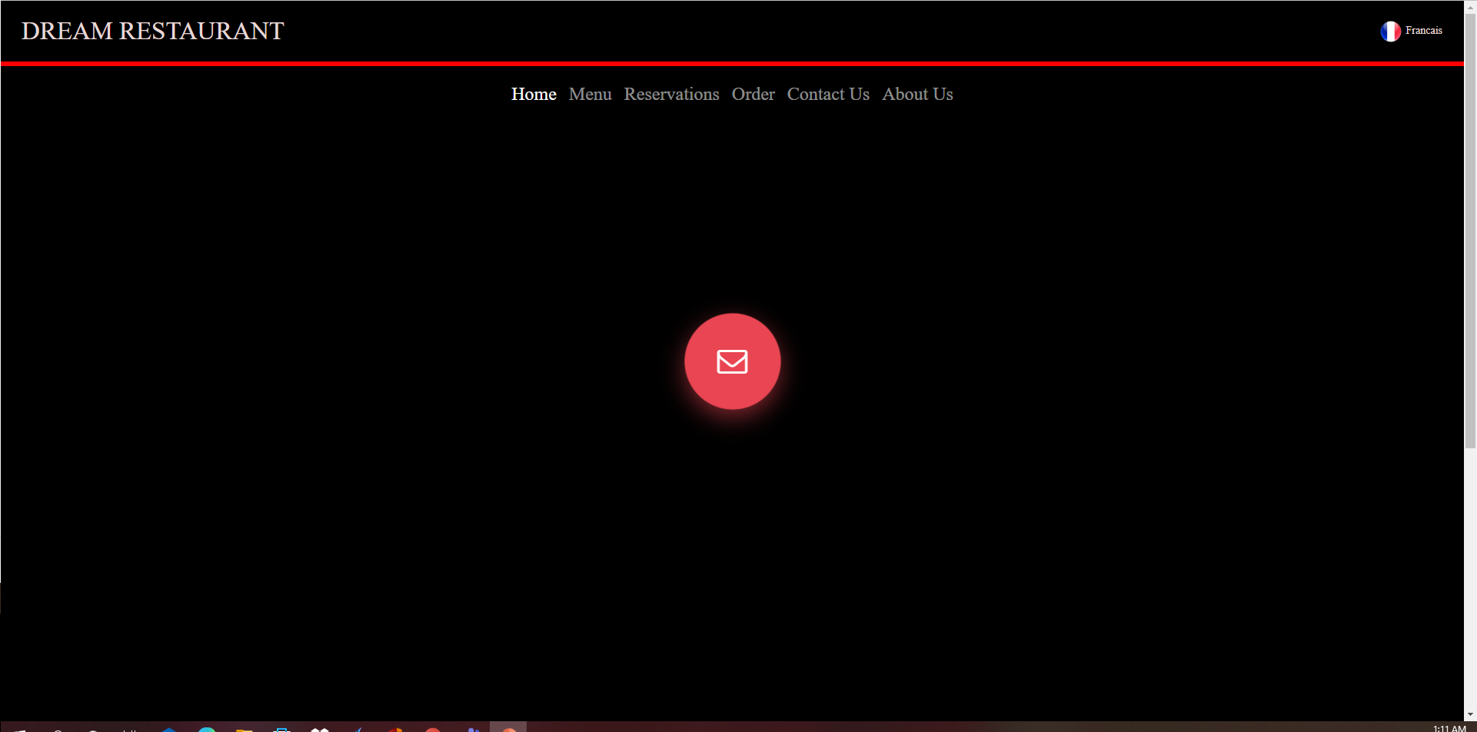
Updated Reservations page

Slide 18
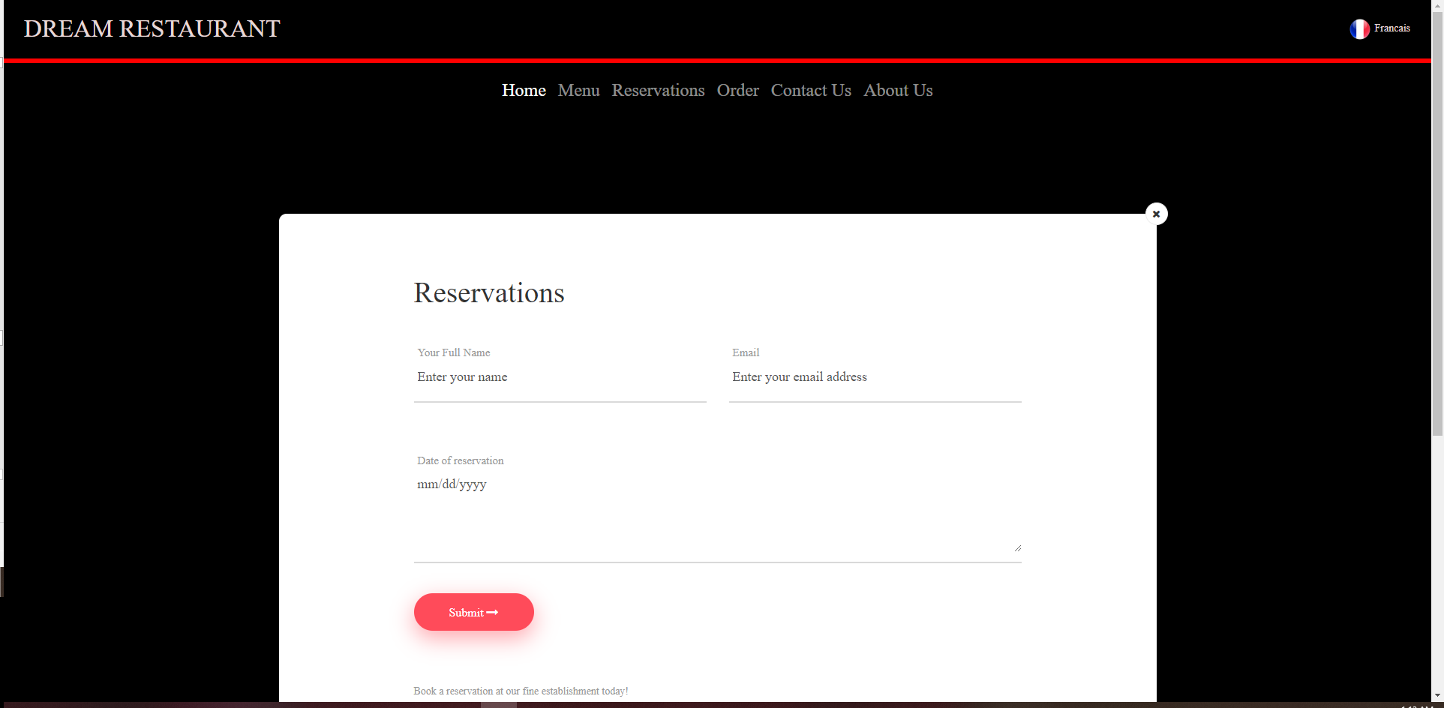
Updated Reservations page (2)

Slide 19
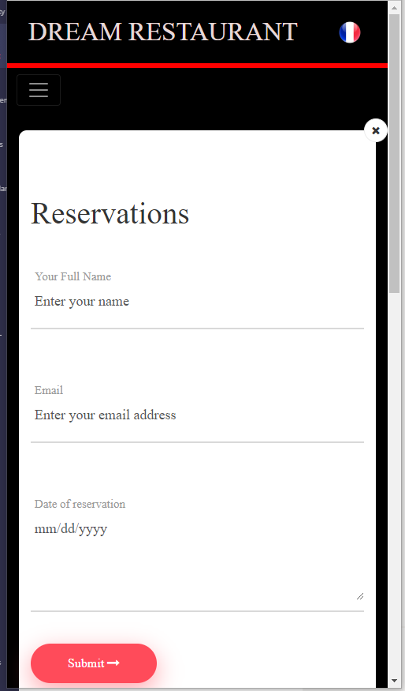
Resized Reservations page

Slide 20
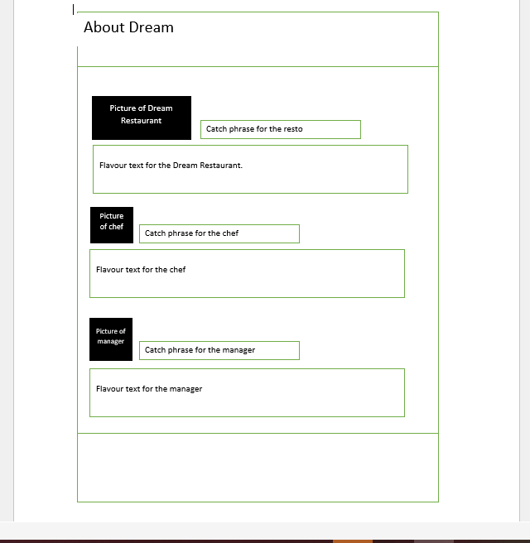
About Us
Purpose of the About Us page is to display a picture of the resto, chef and manager with some back ground information on all three.

Slide 21
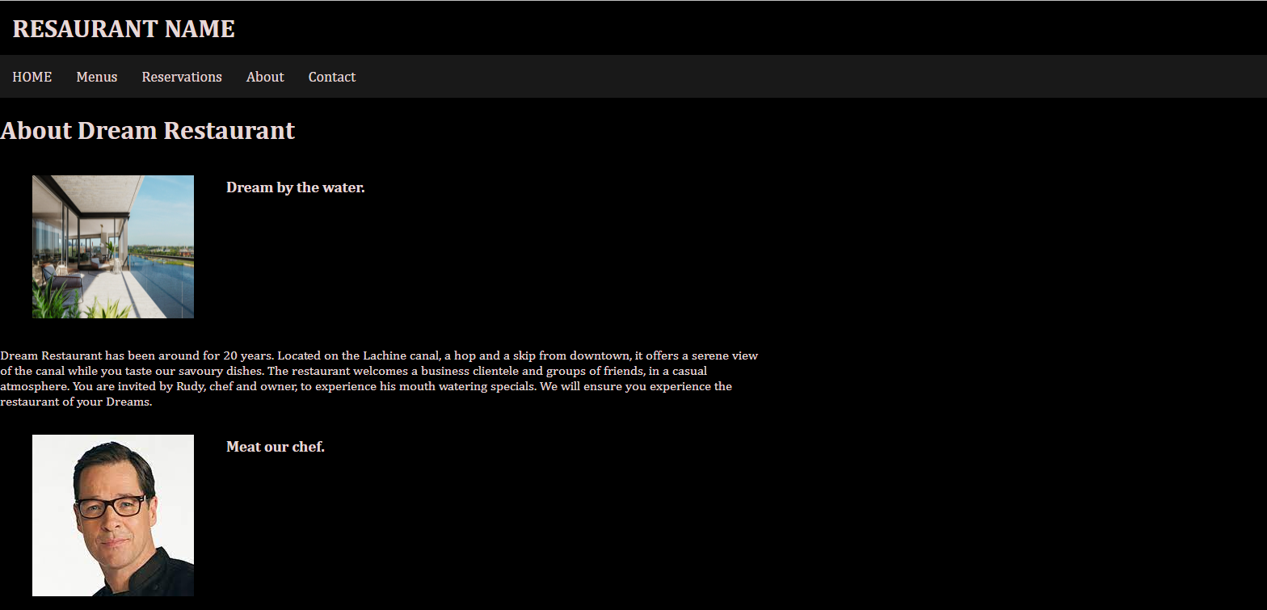
Check out the Resto and the chef…what a smile!

Slide 22
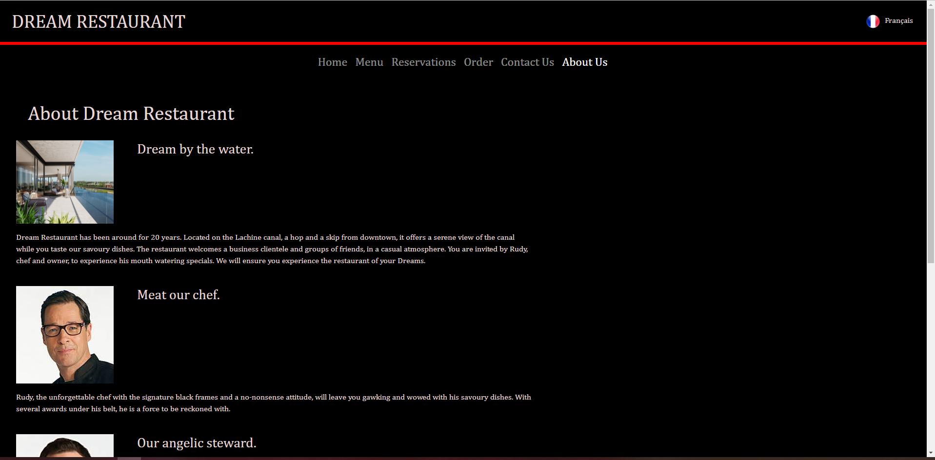
Updated About Us page

Slide 23
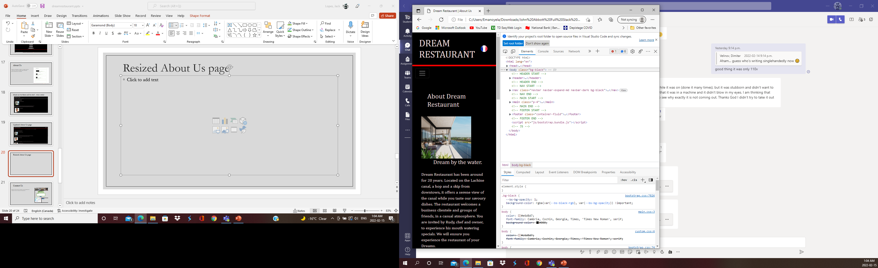
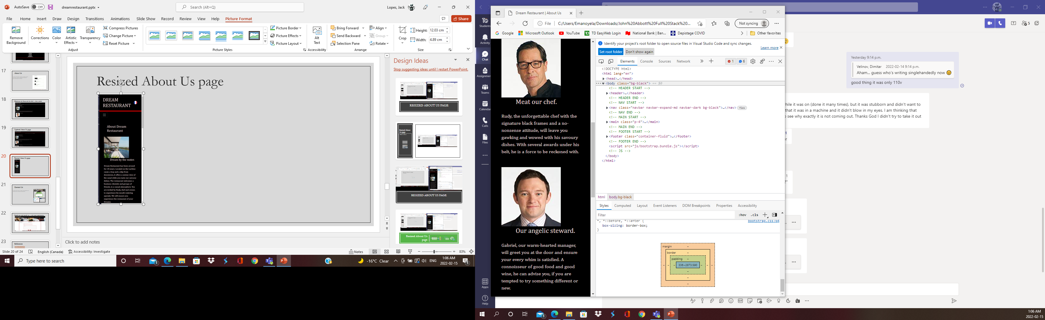
Resized About Us page

Slide 24
Contact Us
Purpose of the Contact Us page is to get feedback and comments from customers and web users.

Slide 25
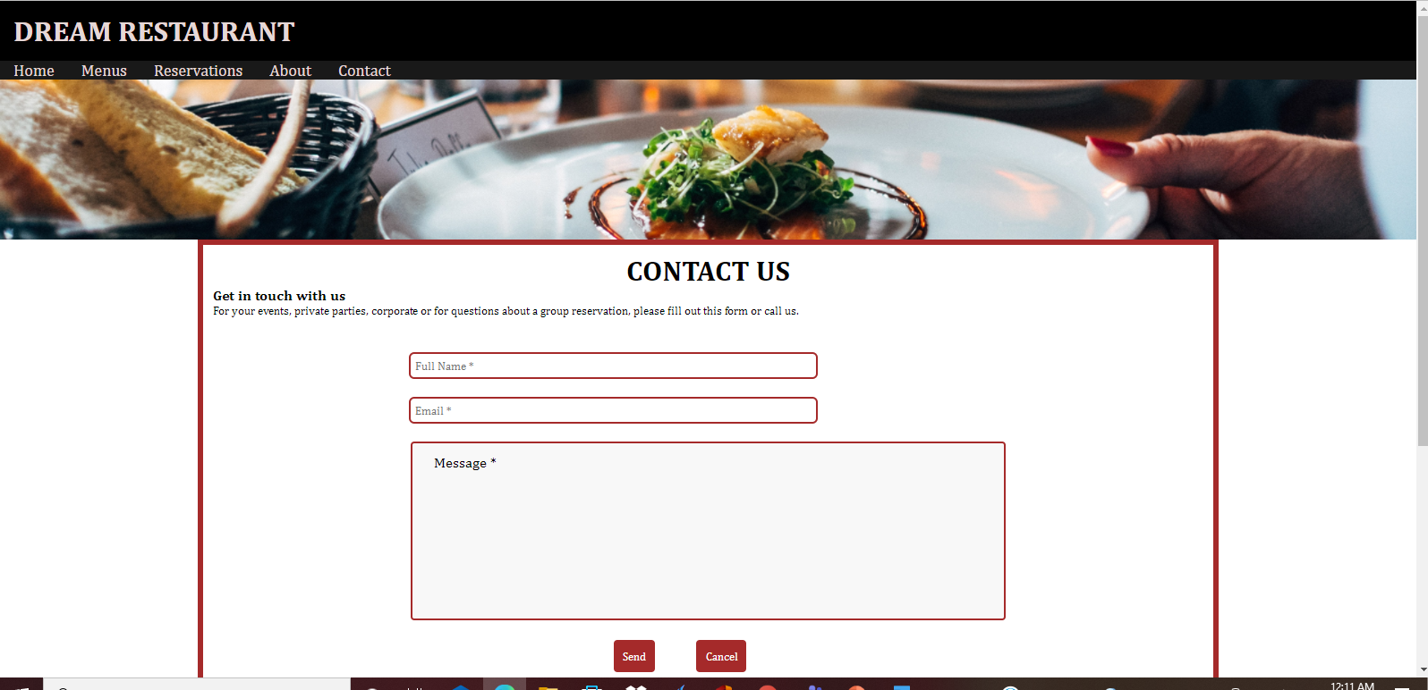
Reach out and touch us…with your comments.

Slide 26
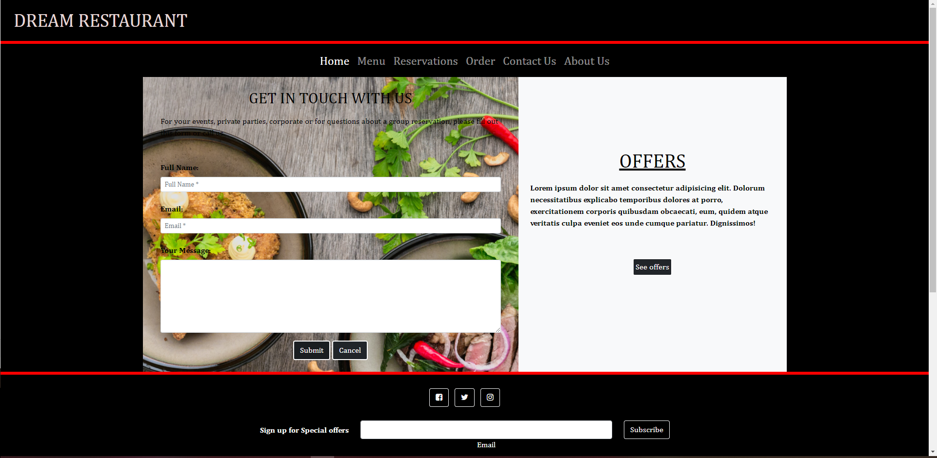
Updated Contact Us page

Slide 27
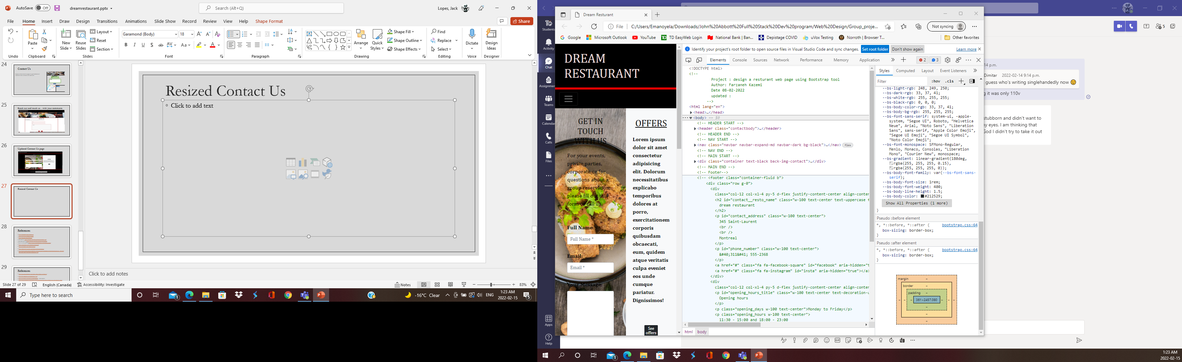
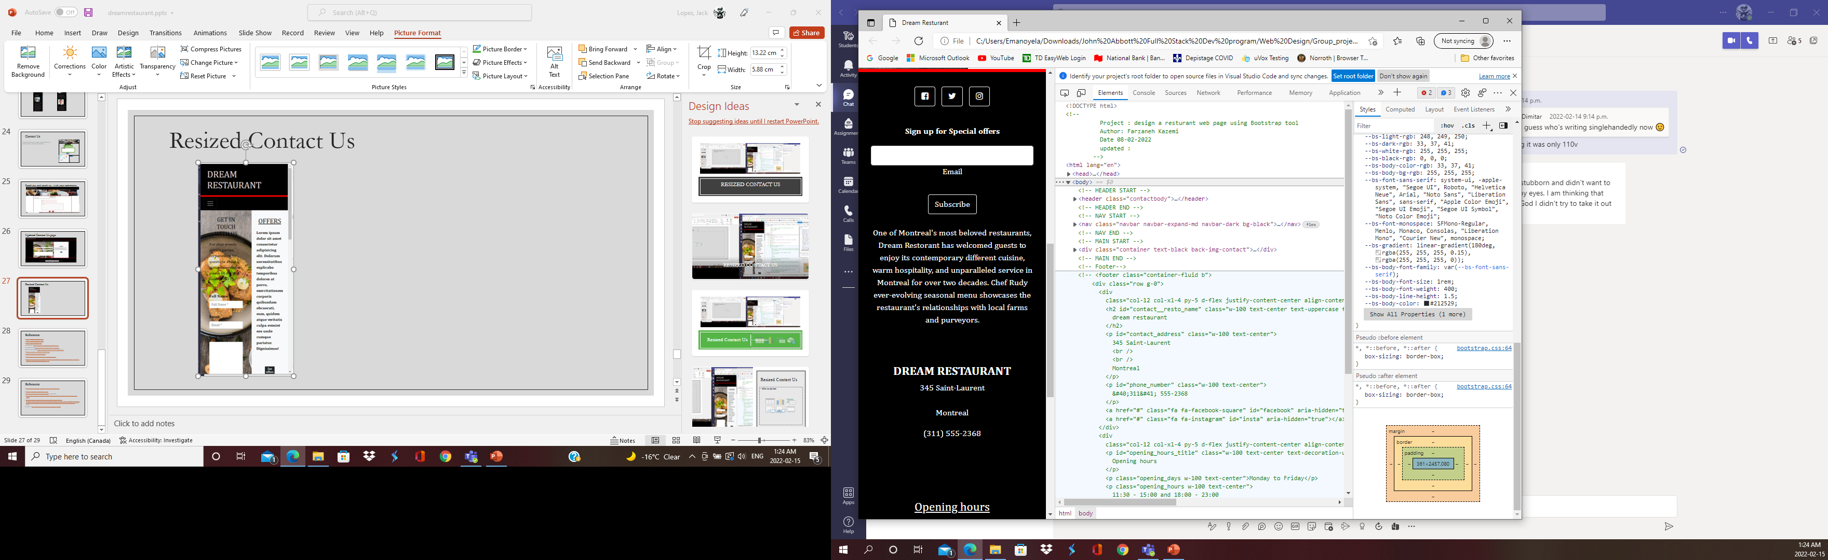
Resized Contact Us

Slide 28
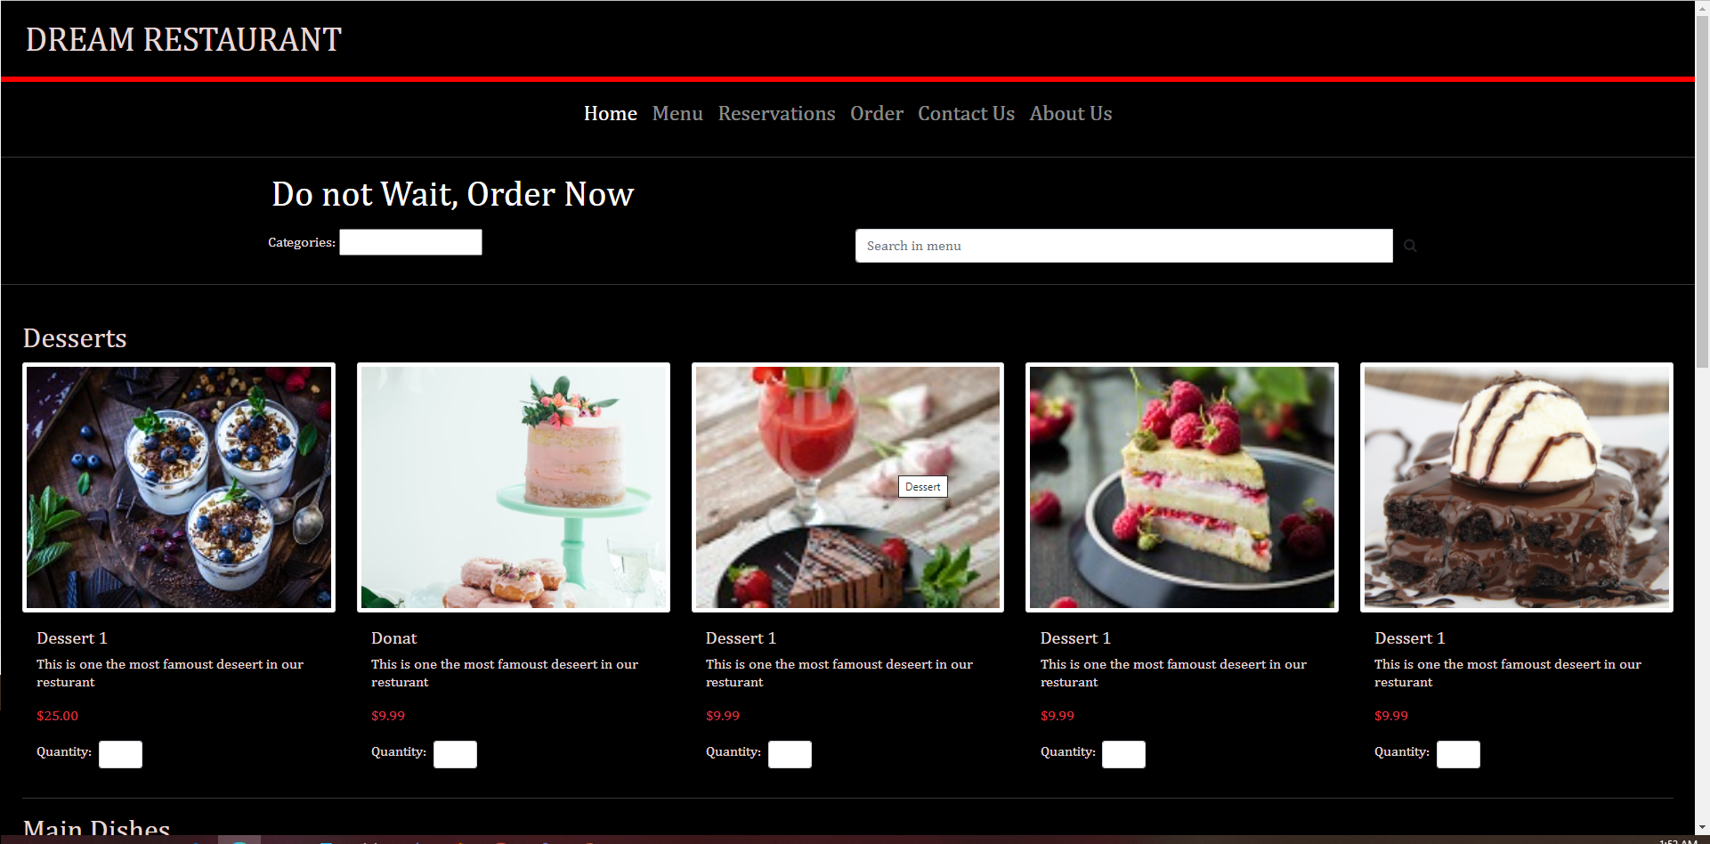
New Orders Page – get it while it’s hot… or cold

Slide 29
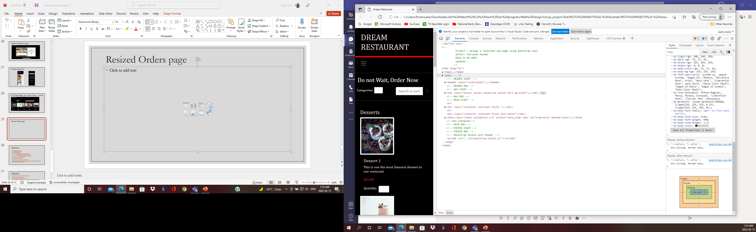
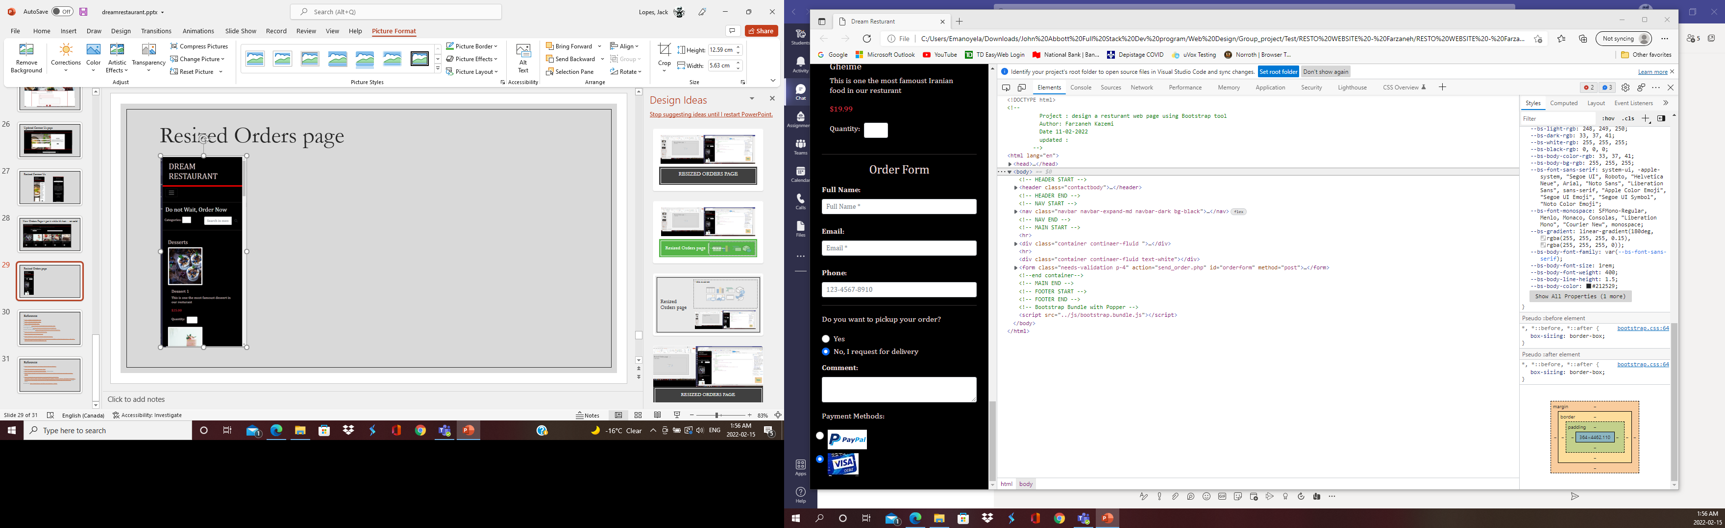
Resized Orders page

Slide 30
References
https://www.lacampagnola.ca/
https://restaurant-damas.com/
https://mechantboeuf.com/
Chef picture: https://sharetv.com/shows/mom/cast/chef_rudy
Manager picture: https://sharetv.com/shows/mom/cast/gabriel
Resto outside picture: https://www.guidehabitation.ca/fr/10145/galdin/
https://unsplash.com/s/photos/restaurant
https://unsplash.com/s/photos/meal
https://alidata127.wixsite.com/dream-restaurant/menus
https://lucid.app/lucidchart/e8492fec-fdcb-49ad-bc79-26c0686c1ccf/edit?invitationId=inv_7057a2f7-2801-47bc-964d-2162fc01d1ad&page=0_0#

Slide 31
References
https://www.budgetbytes.com/green-chile-chicken-enchiladas/
https://en.wikipedia.org/wiki/Finger_food
https://unsplash.com/photos/ZgREXhl8ER0 - saloon photo
https://www.reviewed.com/home-outdoors/features/10-cheesy-recipes-you-can-make-in-a-slow-cooker
https://reviewed-com-res.cloudinary.com/image/fetch/s--tQkCKZCk--/b_white,c_limit,cs_srgb,f_auto,fl_progressive.strip_profile,g_center,q_auto,w_792/https://reviewed-production.s3.amazonaws.com/attachment/d60d15b8ba4b4aec/GettyImages-503193959.jpg - menu photo
insta icon: https://www.flaticon.com/free-icon/instagram_174855

